Slide 1
Introduction to Data Science

Slide 2
Data Science

Slide 3
What is data science?
Data science is a set of fundamental principles that guide the principled extraction of information and knowledge from data. The field of data science enables us to turn raw data into understanding, insight, and knowledge.

Slide 4
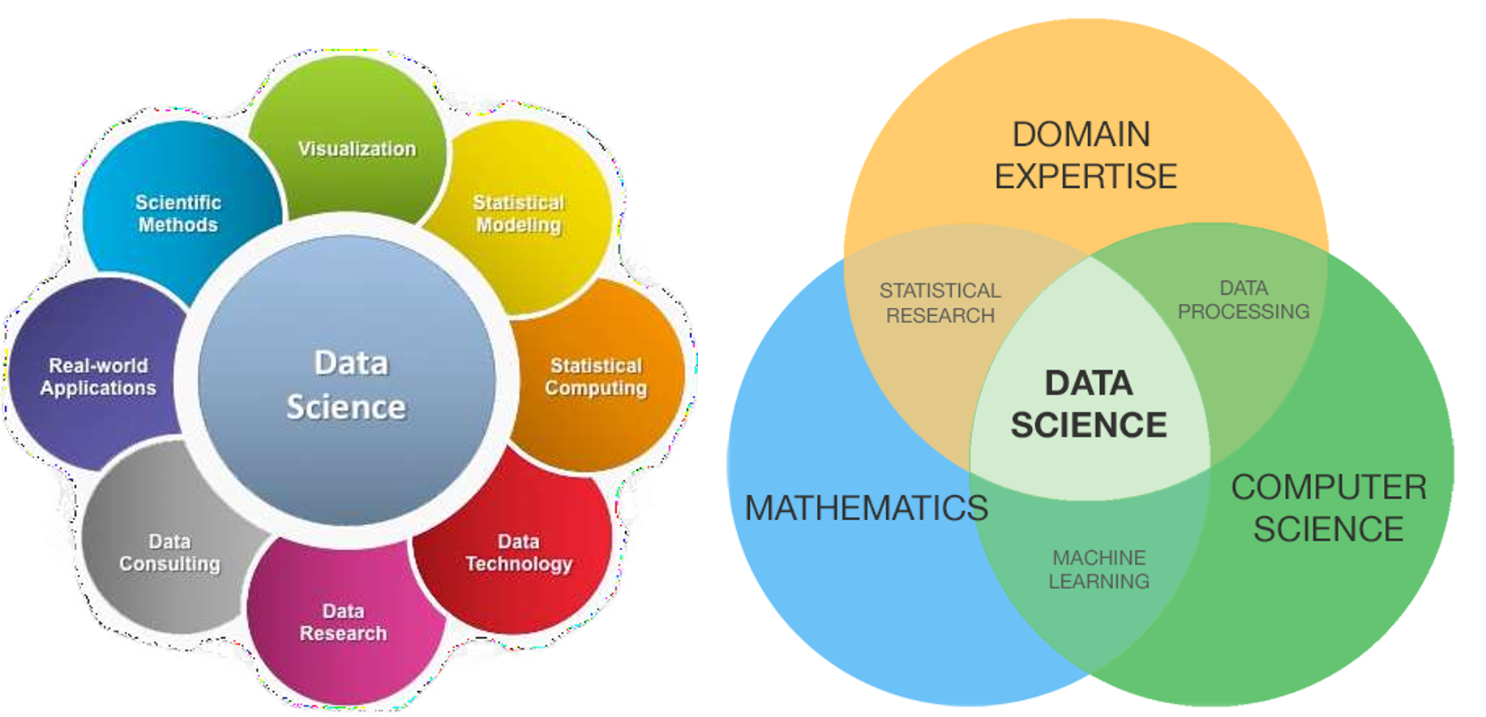
What is data science?

Slide 5
Who is a data scientist?
A data scientist is a professional responsible for collecting, analyzing and interpreting extremely large amounts of data. A data scientist uses their skills in mathematics, statistics, computing, business domain, and the scientific method to give data a shape so that it can better express itself. This job requires the use of advanced analytics technologies, including machine learning and predictive modeling. Data scientist is the sexiest job of the 21st century.

Slide 6
How to become a data scientist?
The following are general steps to becoming a data scientist:
Practice every class activity in this course
Be active in the group discussion
Question everything about data
Ask questions when you don’t understand a concept
Visit other learning resources provided in this course
Learn from your course mate (other students doing this course with you)
Know how to programme
Build projects using the skills learn in this course.

Slide 7
Programming languages for data science
A programming language is a formal language comprising a set of instructions that produce various kinds of output. There are several programming languages for data science, and you as a data scientist should learn and master at least one language for a data science project.

Slide 8
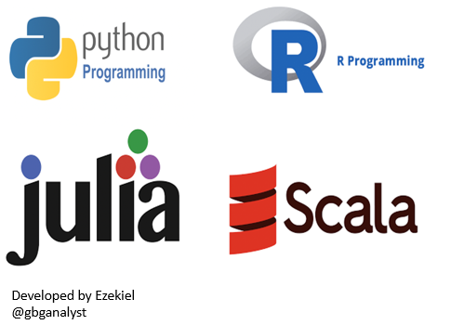
Programming languages for data science
Python is one of the most widely used data science programming languages in the world today

Slide 9
Python libraries for data science
Packages are a collection of related modules that aim to achieve a common goal. The Python standard library is a collection of packages and modules that can be used to access built-in functionality. In an ideal world, you would import any necessary modules into your Python scripts without any issues.

Slide 10
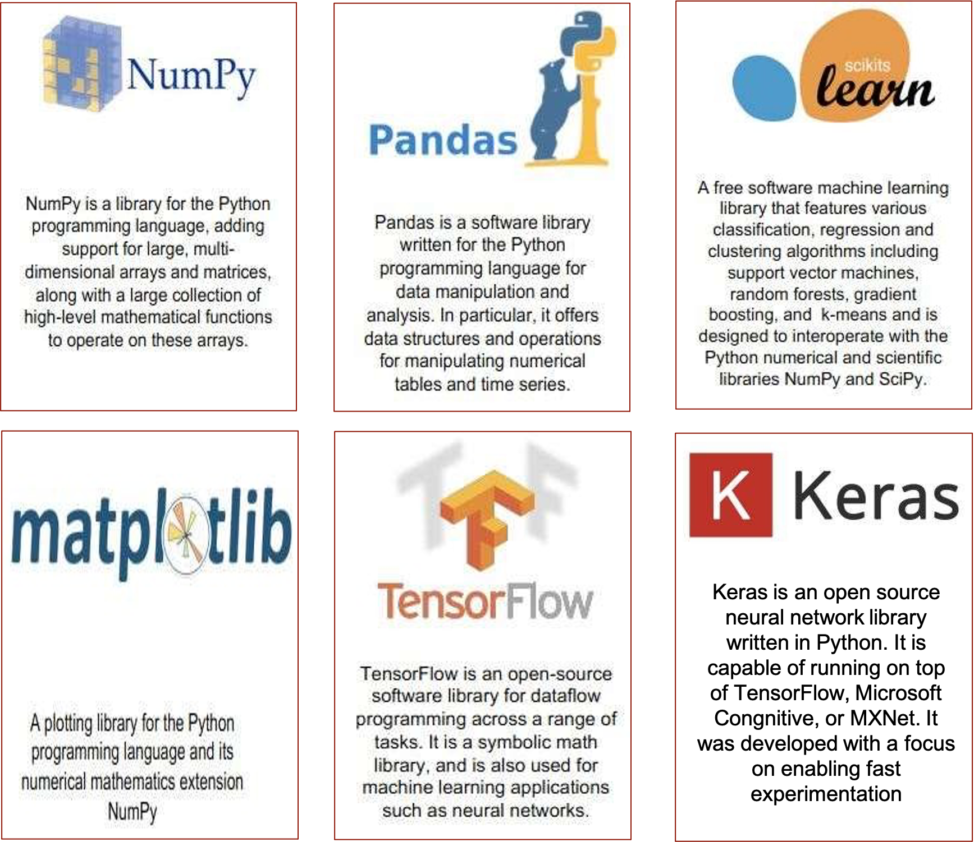
Top 6 most important Python libraries and packages for data science are:
This course will teach you how to use NumPy, Pandas, Matplotlib, and or Seaborn for various data science activities.

Slide 11
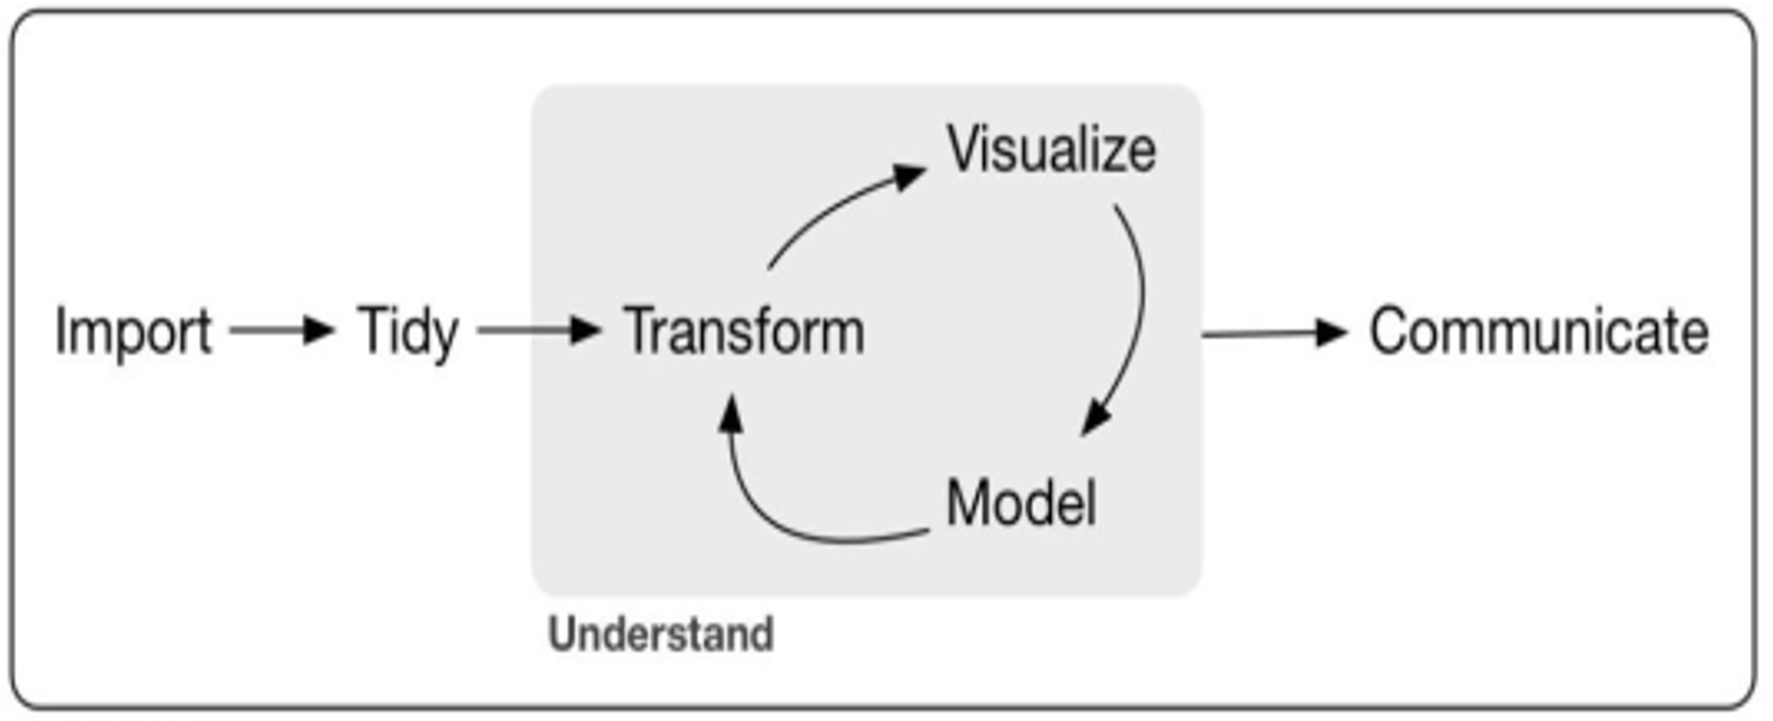
Lifecycle of data science
The general lifecycle of data science involves:

Slide 12
Data Science Use Cases
Data science helps us achieve some major goals that either were not possible or required a great deal more time and energy just a few years ago. The following are the most relevant and efficient data science use cases:
Forecasting (sales, revenue and customer retention)
Pattern detection (weather patterns, financial market patterns, etc.)
Recommendations (movies, restaurants and books you may like)
Anomaly detection (fraud, disease, crime, etc.)
Automation and decision-making (background checks, credit worthiness, etc.)
Classifications (email spam, diseases, phishing website)
Recognition (facial, voice, text, etc.)

Slide 13
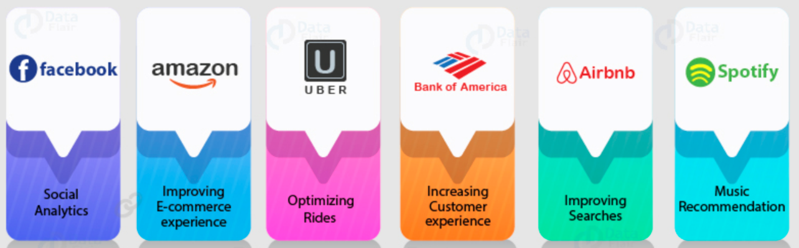
Other use cases by some organizations:

Slide 14
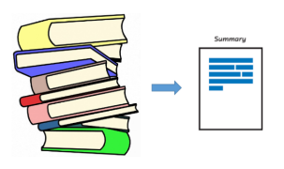
Summary of Study Unit 4
In this study unit, you have learnt that:
Data can come in the form of texts, sounds, images, or numbers written on papers or stored on a computer
Data can be qualitative or quantitative. It is qualitative if it is non-numerical and quantitative if it can be measured in numbers or counts.
The field of data science enables us to turn raw data into understanding, insight, and knowledge
The lifecycle of data science comprises import, tidy, transform, visualize, models, and communicate.

Slide 15


